Slide 1
BIOINFORMATICS PIPELINE PROJECT (BIOPYTHON PROJECT)
YERRA SAI PRAVALLIKA
pravallikaqueen31@gmail.com

Slide 2
BIOLOGICAL SEQUENCE SELECTION FOR RESEARCH
For this project I have taken the protein sequence that is “MULTIFUNCTIONAL CONJUGATION PROTEIN TRAL”
It is taken from the organism ESCHERICHIA COLI K-12
Acession number is “P14565”
Location of the sequence is TRAI1_ECOLI
Length of sequence is 1756 aa
Version of the sequence is “P14565.2”

Slide 3
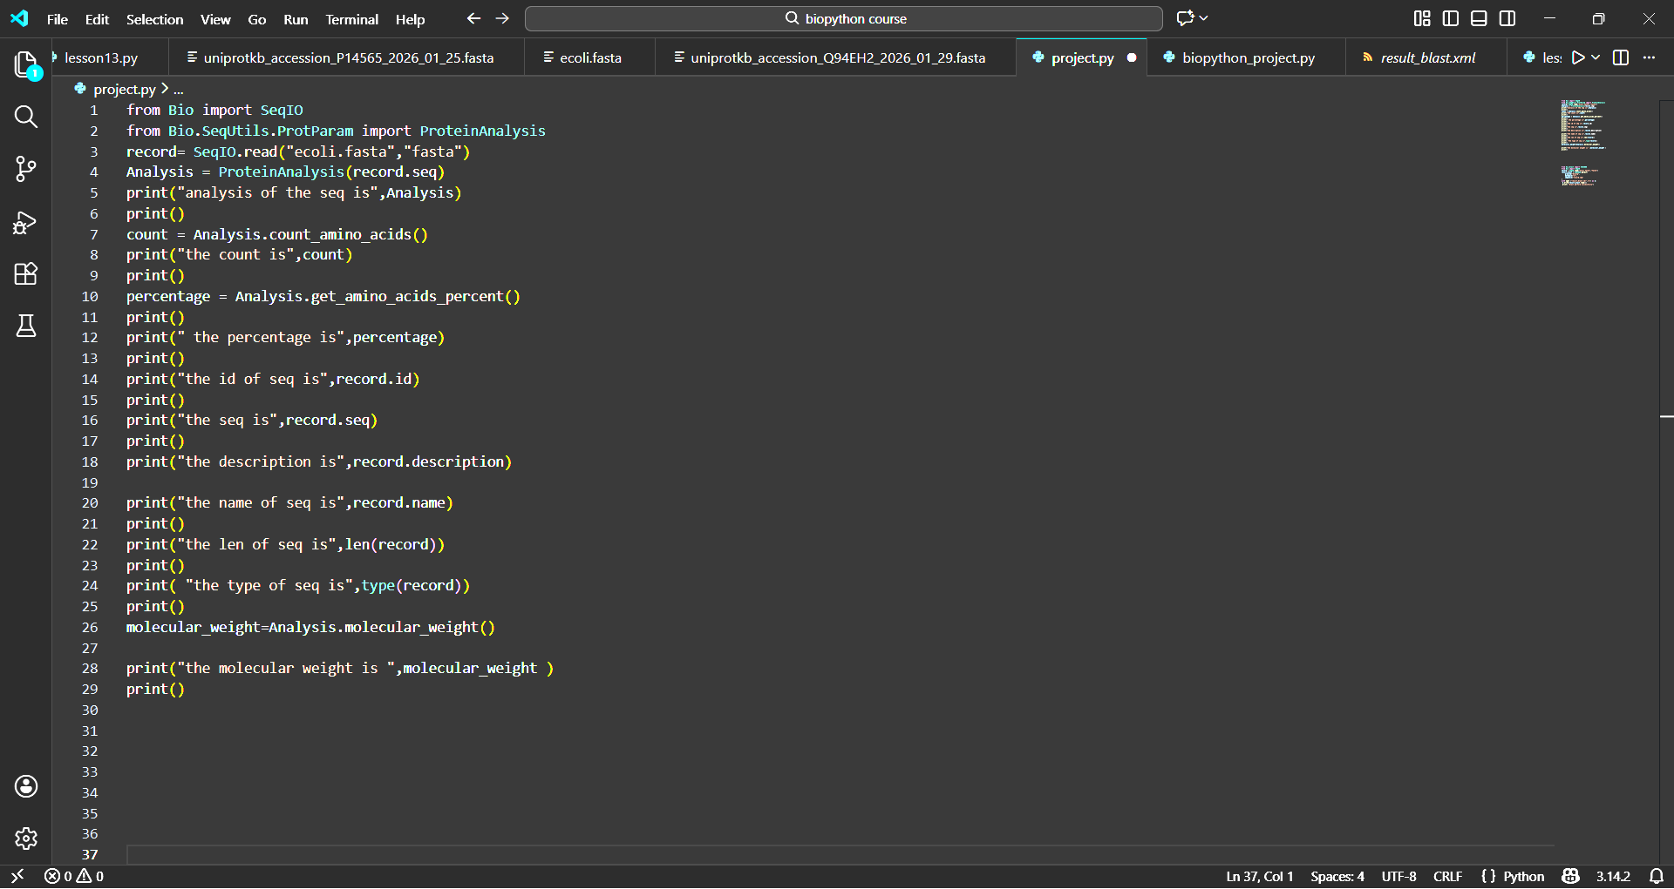
SEQUENCE QUALITY & BASIC ANALYSIS

Slide 4
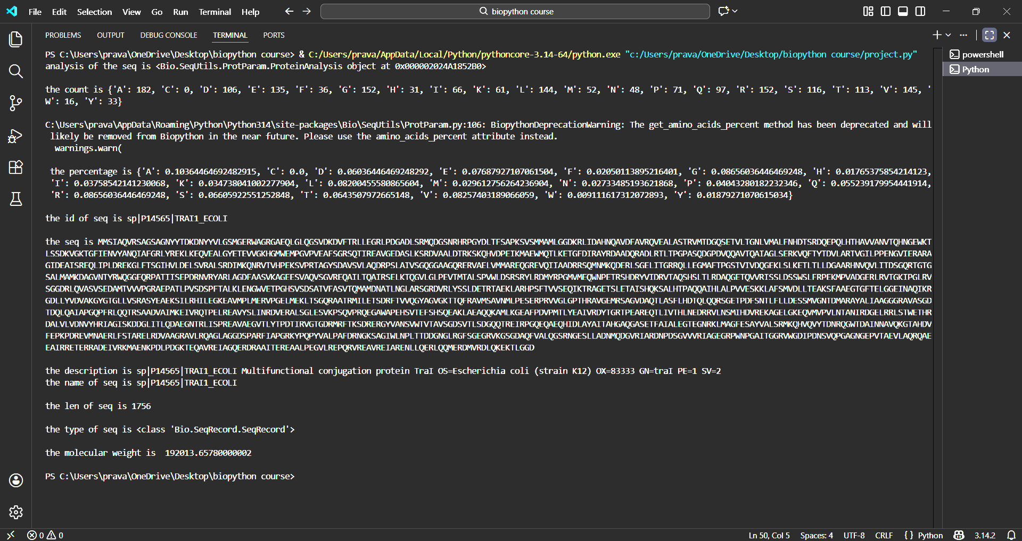
OUT PUT ANALYSIS

Slide 5
SEQUENCE FILTERING & VALIDATION
I preferred this sequence for blast .
Because this sequences length and code quality both are good.
This sequence is suitable for further steps to me.

Slide 6
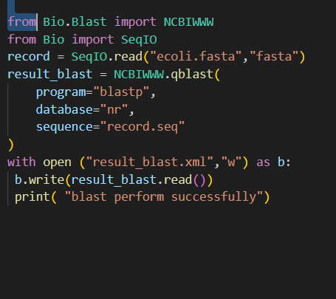
HOMOLOGY SEARCH
xml format project .py file

Slide 7
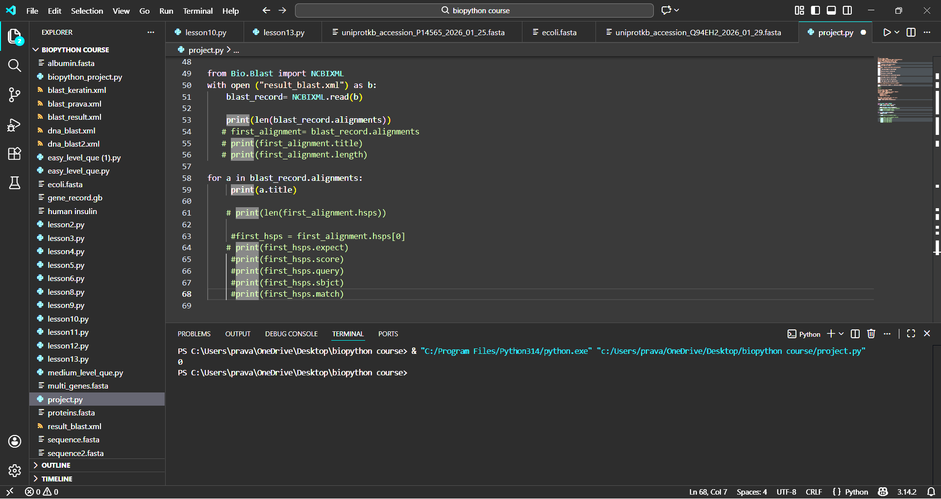
HOMOLOGY SEARCH
There is no significant and similar sequence was found for that sequence in blast.
There is zero alignments are found .
Hence homology based functions are prediction is not possible

Slide 8
BIOLOGICAL INTERPRETATION
What does the sequence likely do?
It acts as a relaxase-nuclease, nicking DNA at the oriT site to initiate plasmid transfer, and as a helicase unwinding DNA for conjugation. This enables horizontal gene transfer of F-plasmid, crucial for bacterial antibiotic resistance spread. Biochemical assays confirm its ATPase-driven helicase activity and site-specific cleavage, while traI mutants abolish conjugation. Structural studies (e.g., AlphaFold, PDB entries) and genetic complementation support these dual roles.

Slide 9
BIOLOGICAL INTERPRETAION
why do they think so ?
In vitro assays show TraI nicks oriT DNA covalently (relaxase activity) and unwinds dsDNA via ATPase-dependent helicase function, matching conjugation needs. ssDNA binding affinity (nM range) and oriT-specific cleavage confirm its plasmid transfer role.
What evidence supports their claim?
Purified TraI demonstrates site-specific nicking at oriT (relaxase activity) with covalent 5'-phosphotyrosine linkage to ssDNA, plus ATPase-driven helicase unwinding at ~1,100 bp/s in vitro. TraY and IHF stimulate relaxosome formation and nicking, confirming conjugation-specific roles.

Slide 10
FINAL OUTPUT
By the end of the Project I want to conclude that,
“I analyzed an unknown biological sequence, validated its quality, identified
homologous sequences but for my sequence there is no homology sequences, and predicted its biological function using computational methods.”

Slide 11
THANK YOU

